Slide 1
The retention problem in MOOC : Why do learners not complete their courses ?
By: Lei Wang
Date: 02/05/2021

Slide 2


Slide 3
MOOC
MASSIVE
On a large scale, an average MOOC course enrolls 43,000 students, some enroll 160,000+
OPEN
Easily accessible to anyone, anywhere, at any time
ONLINE
All course resources are delivered and accessed online
COURSE
High quality, college level courses, some are identical with the on campus courses

Slide 4
Why MOOC?
High quality college level courses
Anyone, anywhere, anytime
Large scale, low cost

Slide 5
Google Trends for MOOC

Slide 6
Is MOOC a silver bullet?
Not a substitute
But a complement
Problems with MOOC

Slide 7
Problems with MOOC
Retention problem
Low perceived value
Cheating/ plagiarism problem

Slide 8
Why is retention a problem
The outcome does not meet the learners’ expectation
The outcome does not meet the instructors’ expectation
A waste of resource: it takes hundreds of thousands dollars to produce one MOOC (source: Hollands and Tirthali 2014)
For platforms, the users’ churn will impact the sustainability

Slide 9
Research objective
Identify patterns of retention
Identify features affecting retention

Slide 10
Research on retention in MOOC
Retention rate
Factors
Strategies
GAP: Retention in the context of learner’s intention

Slide 11
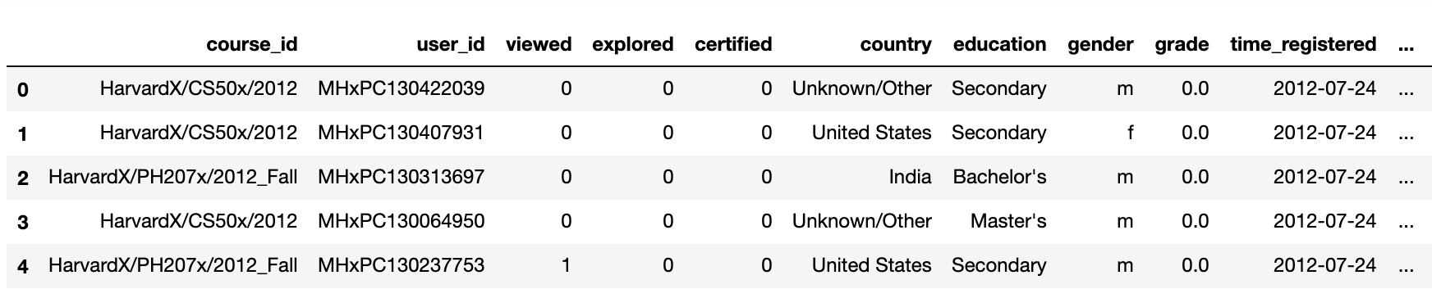
Datasets
HarvardX-MITx person-course academic year 2013 de-identified dataset (Source: HarvardX, 2014)
Academic Year 2013
16 Courses
Person-Course Level
Year 1 Dataset

Slide 12
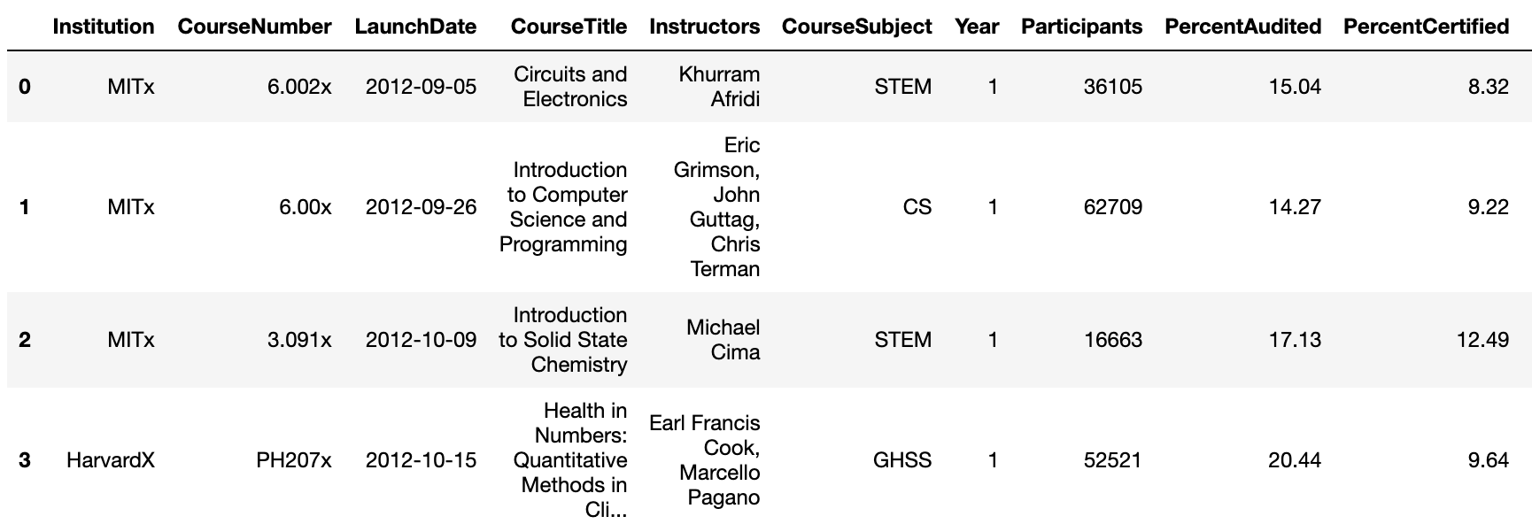
Datasets
HarvardX-MITx year 4 report appendix B dataset
(Source: http://year4.odl.mit.edu/appendix.html)
Academic Year 2013-2016
290 Courses
Course Level
Year 4 Dataset

Slide 13
Operationalizing intention to complete (1)
Glossary
Lifetime: The duration from a learner’s first login to last logout.
Chapter: The highest organizational unit in the courseware
Grade: The weighted average score from quizzes, assignments and tests.

Slide 14
Operationalizing intention to complete (2)
(a) The learner's lifetime is more than 13% of the course duration.
(b) The learner interacted with at least 13% of the course chapters.
(c) The learner's grade is greater than zero

Slide 15
Research questions
(a) What are the retention rates of different subpopulations?
(b) How do course related features affect retention in MOOC?
(c) How do demographic features affect retention in MOOC?
(d) How do learners’ activity related features affect retention in MOOC?

Slide 16
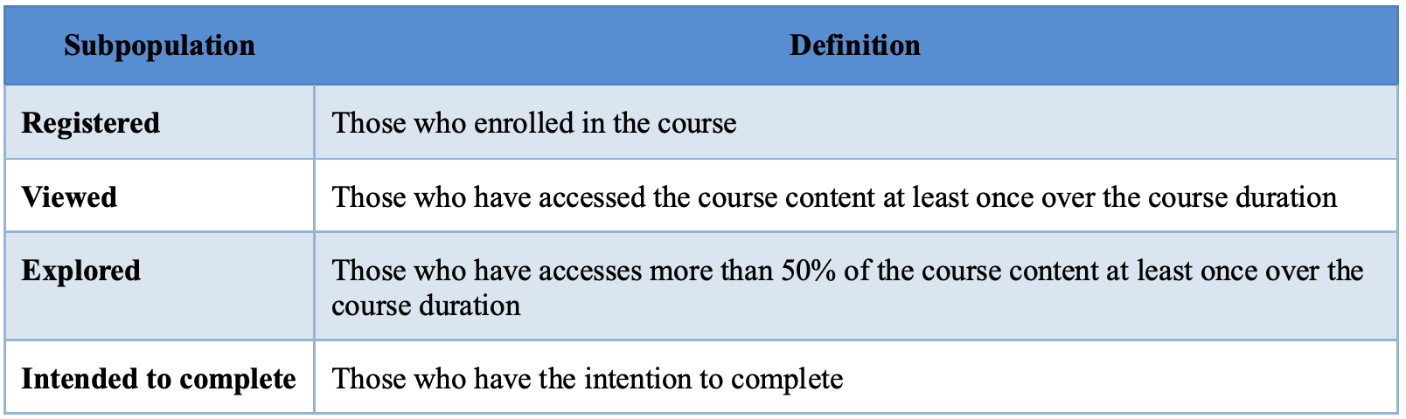
Subpopulations

Slide 17
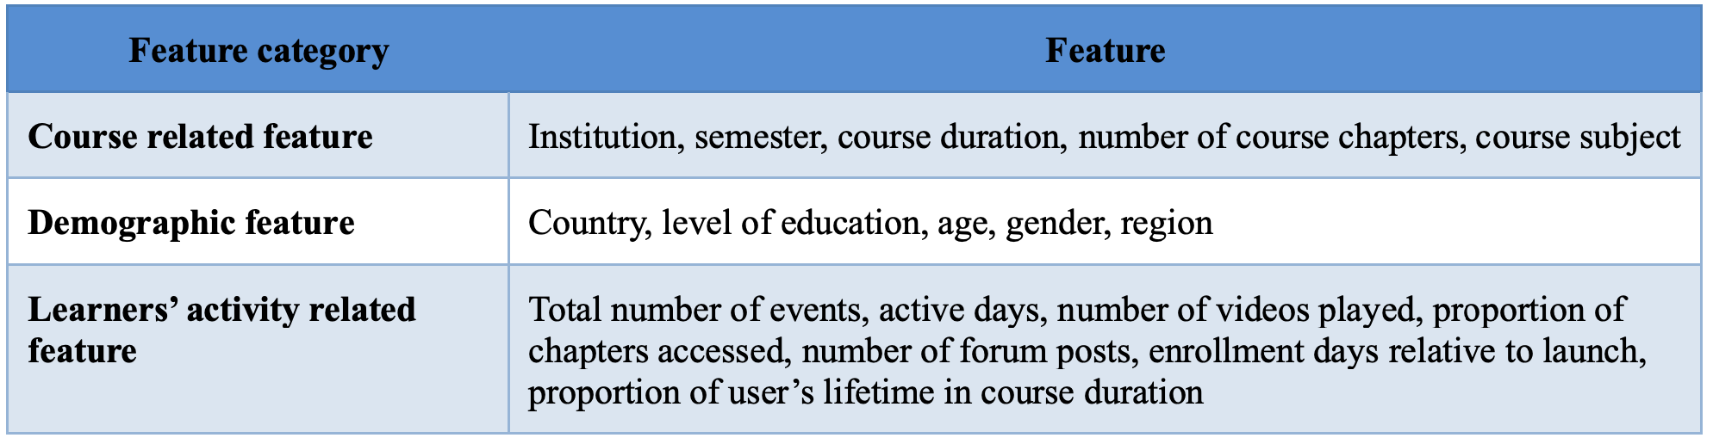
Features categories

Slide 18
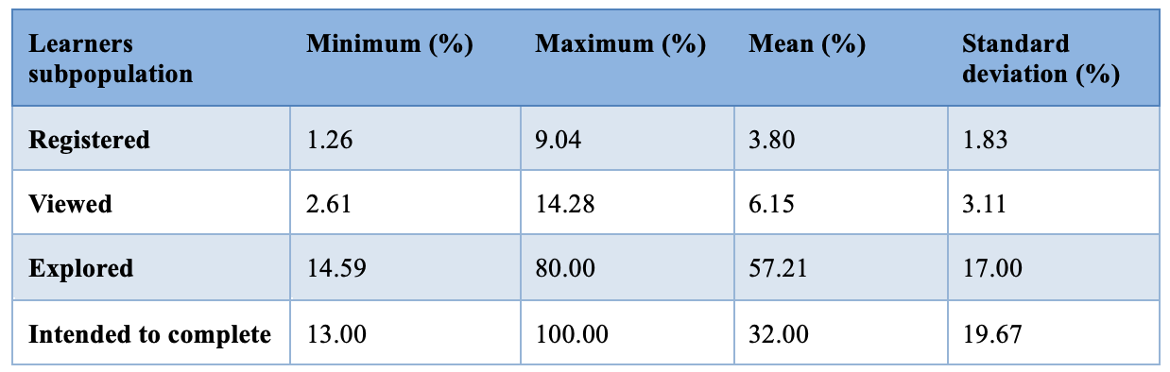
Retention rate for different subpopulations

Slide 19
Features affecting retention
Statistical analysis:
Descriptive analysis
Univariate analysis
Bivariate analysis
Multivariate analysis
Inferential analysis
t-test
chi-square test
ANOVA test

Slide 20
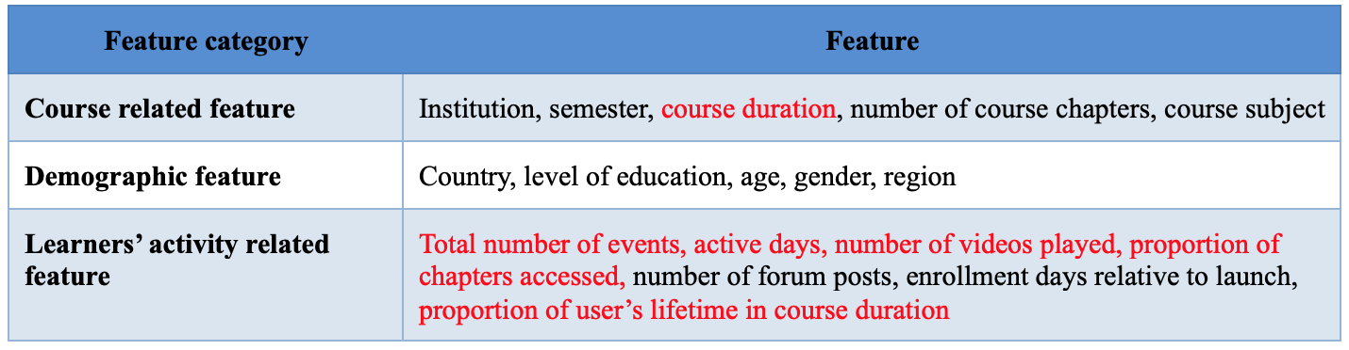
Result: features affecting retention
Strong correlation: active days and proportion of chapters accessed

Slide 21
Machine learning modeling
Statistical analysis
Features
Retention prediction models

Slide 22
Machine learning modeling
Logistic Regression
Random Forest
SVM

Slide 23
Random Forest Performs Best
Prediction time
Accuracy score
F1 score

Slide 24
Statistical tests of machine learning algorithms
McNemar’s test
Logistic Regression vs. Random Forest
Mean P-value for 5 iterations: P<.001
P-value is small, significant difference
SVM vs. Random Forest:
Mean P-value for 5 iterations: P<.001
P-value is small, significant difference

Slide 25
Best classifier
Accuracy score on the test data: 0.92
F1-score on the test data: 0.84

Slide 26
Feature importance

Slide 27
Suggestions for additional research
Introduce pre-course survey to measure degree of intention
Conduct subpopulation clustering with unsupervised learning
Technology features that are specific to MOOC, which ones?
Ohshima sensei’s suggestion

Slide 28
THANK YOU
Q&A

Slide 29
Logistic Regression
Reason
Outputs have a nice probabilistic interpretation
Can be regularized to avoid overfitting.
Can be updated easily with new data using stochastic gradient descent.
m (number of training examples) is large (m=38,622), while n (number of features) is small (n=18)

Slide 30
Random Forest
Reason
Ensemble method, effectively prevent overfitting
Derives from decision tree models, could automatically select features

Slide 31
SVM
Reason
SVM with a linear kernel applies to the condition when the number of training example (m) is large (m=38,622), the number of features (n) is small (n=18)

